Slide 1


Engaging students with sports examples through SCORE
Robin Lock, Ivan Ramler, Nick Clark, Michael Schuckers
USCOTS Breakout, July 2025
Sports Content for Outreach, Research, and Education
Outline for the session: https://github.com/iramler/score_uscots_2025_breakout

Slide 2
In this breakout...
What is Score?
Level 1 – Instructor Choice (Modules)
Level 2 – Student Choice (Datasets)
Level 3 – Student contribution
(Review/Contributions)

Slide 3

What is SCORE?

Slide 4
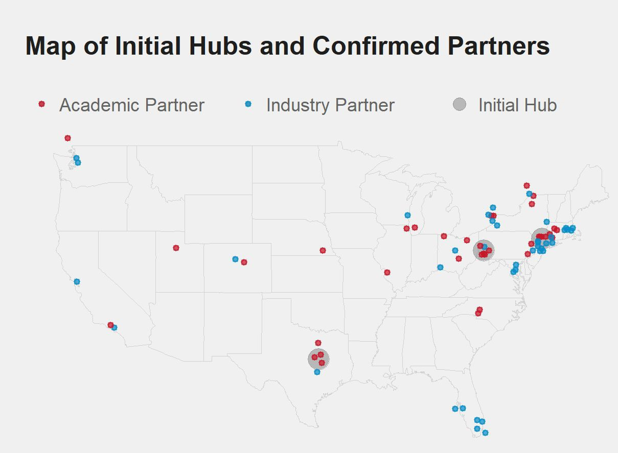
Initial Network
Over 80 initial confirmed partners in academia, industry and media
3 initial hubs
PIT - Carnegie Mellon, Pitt
NY - St Lawrence, West Point, Yale
TX - Baylor
High level advisory board from academia and industry

Slide 5
Levie 1 – Instructor Choice (Modules)
A SCORE module is a set of teaching resources built around one (or more) sports-related datsets
Plug and Play into your classroom with flexibility
Open Access (download and (usually) edit)
Peer Vetted with DOIs (Pedagogy, Industry, Student)
Sports motivated with background materials
Diversity of sports esp. Non-traditional sports

Slide 6
Module Components
Sports Setting
Introduction/Motivational Video
Learning Goals/Methods (Statistical/Data Science)
Dataset(s)
Data Glossary
Exercises/Activities (inline or downloadable worksheets)
Solutions
Conclusion

Slide 7
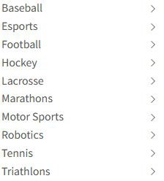
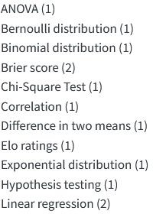
Module Repository
https://modules.scorenetwork.org/
19 Published Modules
70+ more in preprint repositories
13 different sports among published Numerous more in preprints
Searchable by sport or statistics topic

Slide 8
Three Module Examples
League of Legends - Buffing and Nerfing
NBA Wingspan & Performance (SLU Preprint)
Marathon Record-Setting Over Time

Slide 9
Levie 2 – Student Choice (Datasets)
The SCORE Data Repository includes lots of datasets that instructors can use for class examples and students can use for individual projects.
Each dataset includes:
Descriptive title
Brief description of the sport/data background
Tags with relevant statistics and data science topics/categories
Link to data file and description all variables
Example questions associated with the data
Original source of the data

Slide 10
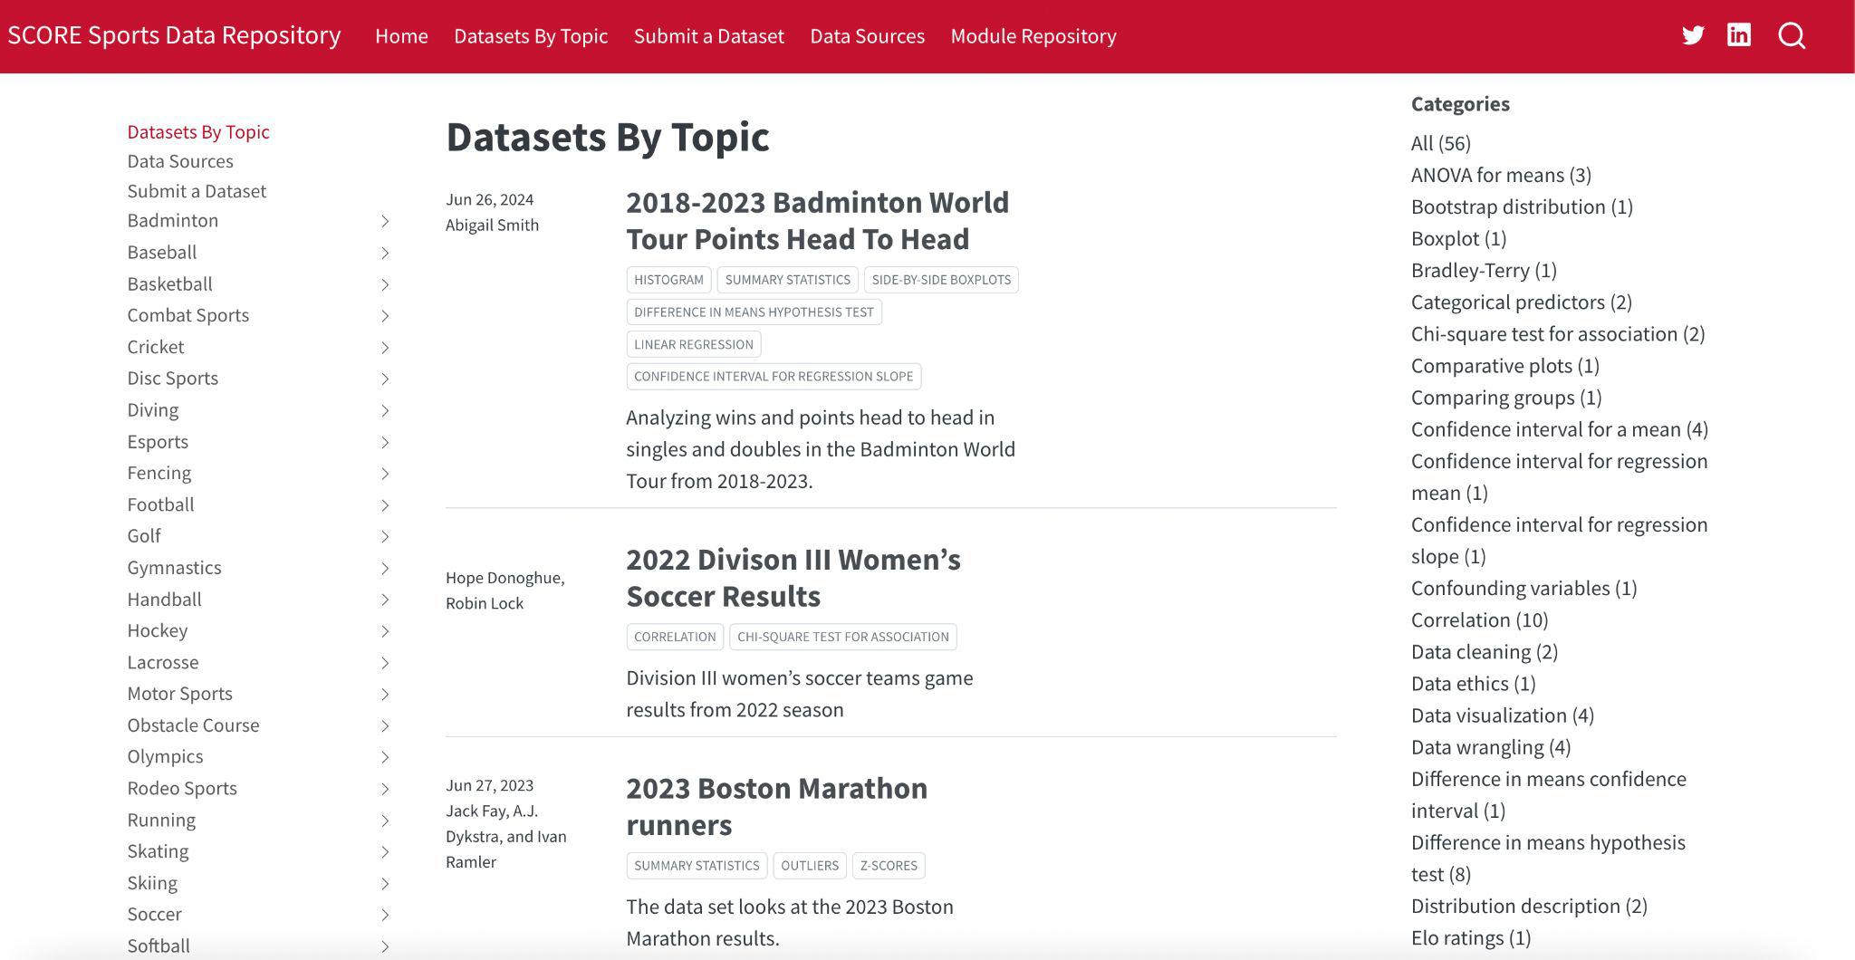
SCORE Data Repository https://data.scorenetwork.org/
Features over 70 datasets across more than 30 different sports
Can search for datasets by sport and by statistics & data science topic

Slide 11
ACTIVITY – Find Some Data!
Project #1: Data Description (early semester)
Dataset with at least 30 cases and information for at least one categorical and 3 quantitative variables. Use summary statistics and graphs to describe individual variables and any interesting relationships between them.
Project #3: Regression
Find a dataset with a quantitative variable that you would like to predict and 3-5 potential predictors. Look at scatterplots, correlations, and simple linear models to see which are effective predictors (possibly also include multiple regression models).

Slide 12
Level 3 – Student Contributions
Students can contribute to the SCORE project by reviewing modules and/or submitting their own datasets or modules.
Google form for Student Reviews Form will include a dropdown list of modules to review
Submit a module, module idea, or dataset Page instructions on how to submit materials to SCORE and guidelines for formats.

Slide 13
SCORE Student Seminar
¼ unit (one credit) course for students to develop SCORE materials.
Meets once a week for an hour
5-8 students
Students start by reviewing existing modules, then finding interesting data (for a data submission), then developing one or more modules for the data.
Regular opportunities to present at weekly meetings.

Slide 14
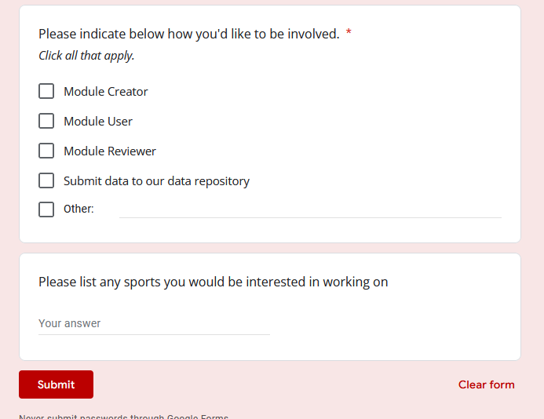
Want to Get More Involved with SCORE?
Join the Network!

